Slide 1
ANALYTICS TOOL FOR PLACEMENT CELL
RASHINI H 211520243043
POONGUZHALI B 211520243041
KEERTHE B 211520243026
SANGEETHAA P 211520243049

Slide 2
INTRODUCTION:
Our project is mainly focused on analysis and tracking of student Performance in placement drives. To implement this application, coordinator has to collect the student’s data, those who are eligible and qualified for the aptitude and future rounds.
The current system is computerized one, but it does not meet the needs of Training and Placement Cell. In existing system, the student’s data is maintained in Excel Sheets.
According to the Company’s Requirement the daThe main purpose of this project is to add new features to existing system. The proposed one is an online system which can be accessed throughout the Organization and outside as well with valid login credentials.
This system can be used as an application for the Training and Placement Department of the college to manage student’s information regarding Placements.ta is short listed manually by the TPO's.

Slide 3
ABTRACT:
ABTRACT
The Project Named “ANALYTICS TOOL FOR PLACEMENT CELL” is a student/company web-based Information system. Training and Placement Cell is the management cell it is supported by databases. Training and Placement has a major role in every college in which most of the work till now is carried out manually.
The Main aim of this project is to Automate the Training and Placement procedure in our college. This project reduces manual work and maximum the optimization, abstraction and security. This is a web application which will help students as well as the administration authority to carry out each and every activity in campus hiring.
This system is an application that can be accessed throughout the organization and outside as well with proper login credentials. This system can be used as an application for the Training and placement cell of the college to manage the student information with regarding placement recruitment.
Students able to view eligibility criteria based on their CGPA for the up-coming placement drives and they can access technical and QA papers regarding particular company.

Slide 4
Project Objectives:
This project is designed to help students for applying jobs. Placement management system mainly focused to interact the student and company.
Students can create profiles on the system directly. They can edit their profiles and the student profiles can be viewed by the recruiters. It will help to apply for the job where they fit in.
Students can only apply jobs when they match with the eligibility criteria.
The IRP admin manages with the permissions of the department admin and the department admin manages all the things which are related to the students and recruiters

Slide 5
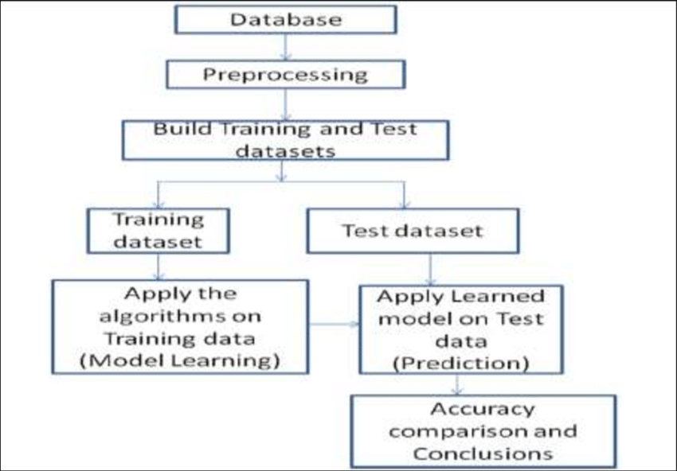
ARCHITECTURE DIAGRAM:

Slide 6
EXISTING SYSTEM:
The Existing system does all process has done by manually. Placement officers maintain the information about students manually. If any modifications or updates are required in their profile of any students, it has to be done manually. This is very difficult task for TPO to maintain the student data and company details as it is time consuming, lack of security of data and also it takes more man, etc,. This is so difficult to the Tpo when number of user's increases
Existing systems and tools in placement analytics are:
Applicant Tracking Systems (ATS): ATS software helps manage job applications and streamline the recruitment process. It allows recruiters to track candidates' progress, store resumes, and collaborate with team members.
Job Boards: Platforms like LinkedIn, Indeed, and Glassdoor provide analytics tools for employers to track the performance of job postings, view applicant demographics, and assess the effectiveness of their job advertising.
Predictive Analytics Tools: These tools use historical hiring data and machine learning algorithms to predict which candidates are most likely to succeed in a role. They can help companies make more informed hiring decisions.

Slide 7
LIMITATIONS:
Analytical tools can provide data-driven insights into the performance of ad placements. This data helps advertisers and marketers make informed decisions on where and how to allocate their advertising budgets
Ad placement analytical tools can help calculate the return on investment (ROI) for different ad placements. Advertisers can identify which placements are most cost-effective and generate the highest returns
These tools often include audience analytics, allowing advertisers to understand the demographics and behaviors of the audience reached by specific ad placements. This information can help refine targeting strategies.
Analytical tools can track key performance metrics such as click-through rates (CTR), conversion rates, and engagement levels for different ad placements. This information is crucial for optimizing ad campaigns
Advertisers can use these tools to conduct A/B tests on different ad placements, ad creatives, or targeting parameters to determine which variations perform best.

Slide 8
PROPOSED SYSTEM:
The proposed website includes the following features:
• Training and placement department maintains the details of each student.
• Students can view the status of their upcoming campus.
• Search feature helps to admin because they check particular student is present or not
• Admin can only update student details and academic records like email id, current semester, correspondence address and marks obtained in different semesters via csv file.
• Provides a proper communication channel between student and training & placement department using the Sms.
• Latest information about which company is visiting the campus is provided in the website which helps the students to get updated information quickly.
• Website is user friendly with more GUI so that student view the information easily.
• Duplicate registrations can be avoided and hence it provides reliability.
• Only administrator can modify the Placement and organization record if needed.
• website more helps to make a short list of students who get placed in certain Company and who is unplaced. student can manage passwords, access technical papers and view eligibility criteria for on-going recruitments. Coordinators maintaining the attendance records of CRT classes.
.

Slide 9
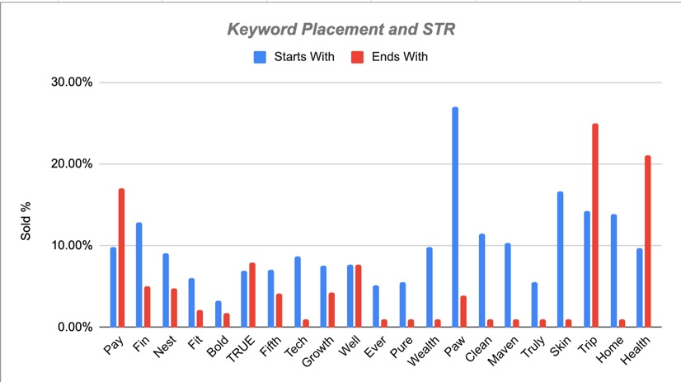
RESULTS:
FIG :PLACED STUDENTS

Slide 10
CONCLUSION:
Various classification and clustering techniques are inspected to evaluate the performance of students in the recruitment procedure. Using the comparative study amongst these techniques ID3 with accuracy 95.33%, KNN with 97.33%, C4.5 with 88.89%, Naïve bayes with 86.15 %, Multilayer perception having 87.395% accuracy is suggested to be the best one.
If placement cell conduct workshop in advance for pre-final year to train them according to the result of these techniques, students will be able to identify their scope of improvement and will be able to refine themselves accordingly.

Slide 11
FUTURE SCOPE:
It would of great help if we revise and update our curriculum and other extra activities for each semester in accordance with the public, private and government sector requirement.
We can also predict which company picks which category of students.
Make a list of skill a particular company looking for, then on the basis of that we can train our student. These traits will make prediction process more accurate

Slide 12
REFERENCES:
Vidhate, Deepak A and Kulkarni, Parag “Innovative Approach Towards Cooperation Models for Multi-agent Reinforcement Learning (CMMARL)”, Springer Nature series of Communications in Computer and Information Science, Vol. 628
Vidhate, Deepak A and Kulkarni, Parag “New Approach for Advanced Cooperative Learning Algorithms using RL Methods (ACLA)” Proceedings of the Third International Symposium on Computer Vision and the Internet, ACM, pp 12-20, 2016
T. Jeevalatha, “Performance Analysis of Undergraduate Students Placement Selection using Decision Tree Algorithms”, Dept, ofComputer Science Dr. N.G.P Arts and Science College Coimbatore Tamil Nadu, India.
Dr. Rajan Vohra, “Generating Placement Intelligence in Higher Education Using Data Mining”, Head of Dept. Computer Science & Engineering Dept P.D.M College Of Engineering, Bhadurgarh , Haryana(India).
Tejashri Gosavi, Shraddha Gaikwad, “Android Based Training and Placement Automation”, Department of Computer Engineering, JSPM’s ICOER , Wagholi , Pune , India

Slide 13
THANK YOU

